Slide 1

Title
Authors
Department of Chemistry, University of Kansas, Lawrence, KS, 66045
Abstract
Data
Methodology
Background
Data
Conclusions
References
Acknowledgments
KU is an EO/AA institution.

Slide 2




Title
Authors
Department of Chemistry, University of Kansas, Lawrence, Kansas 66045
Header

Slide 3

TITLE
AUTHOR
Department of Chemistry, University of Kansas, Lawrence, KS 66045
OVERVIEW
TEXT
SECTION
text
SECTION
TEXT
SECTION
TEXT
SECTION
TEXT
SECTION
TEXT
SECTION
TEXT
ACKNOWLEDGEMENTS
TEXT

Slide 4




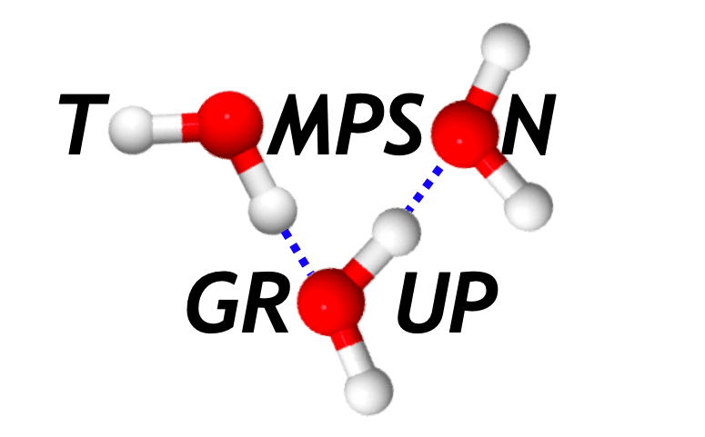
Title
Authors
Department of Chemistry, University of Kansas, Lawrence, Kansas, 66045
ABSTRACT
METHODOLOGY
OSMOLYTE-WATER SYSTEMS
.
INTRODUCTION
RESULTS
CONCLUSIONS
REFERENCES
ACKNOWLEDGMENTS

Slide 5
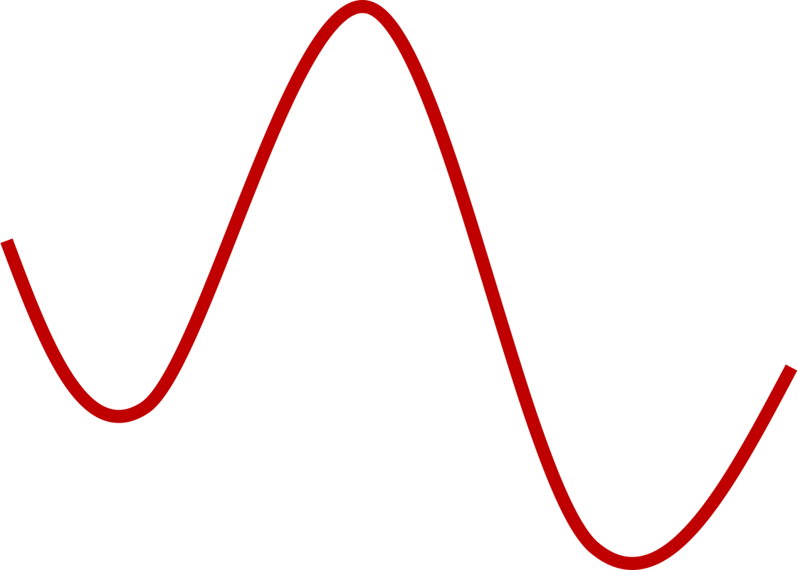
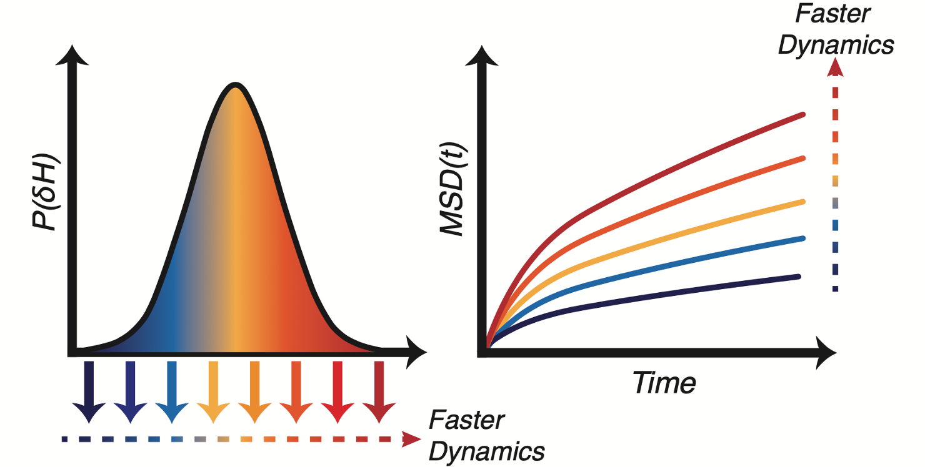
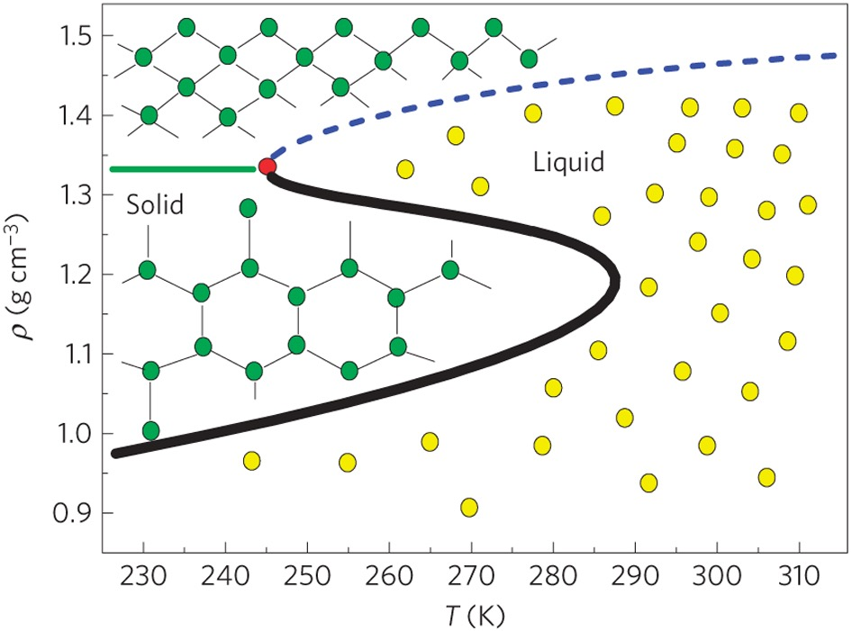
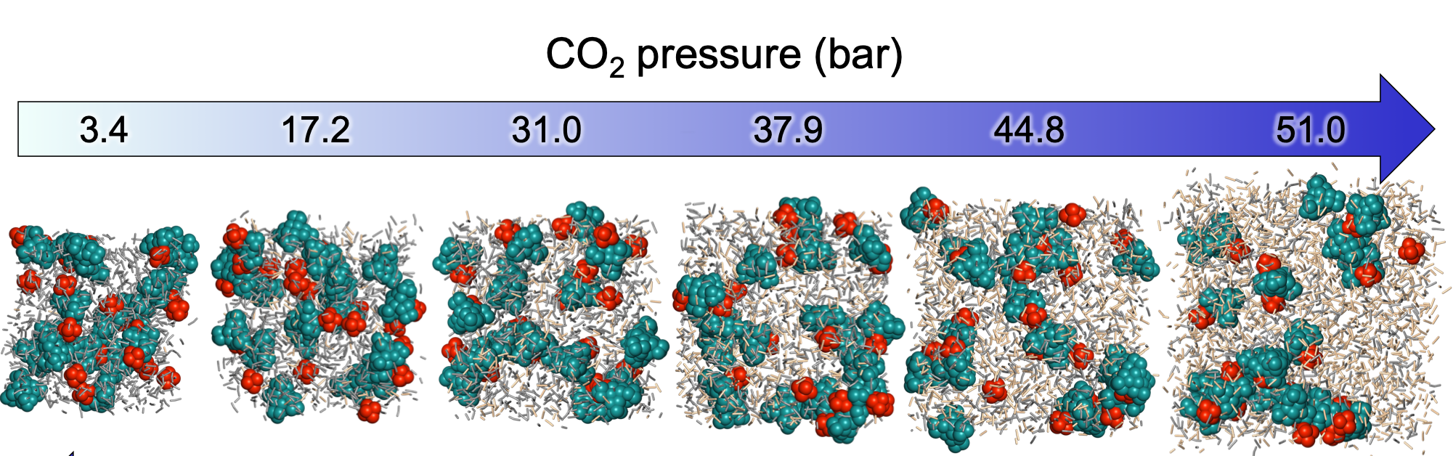

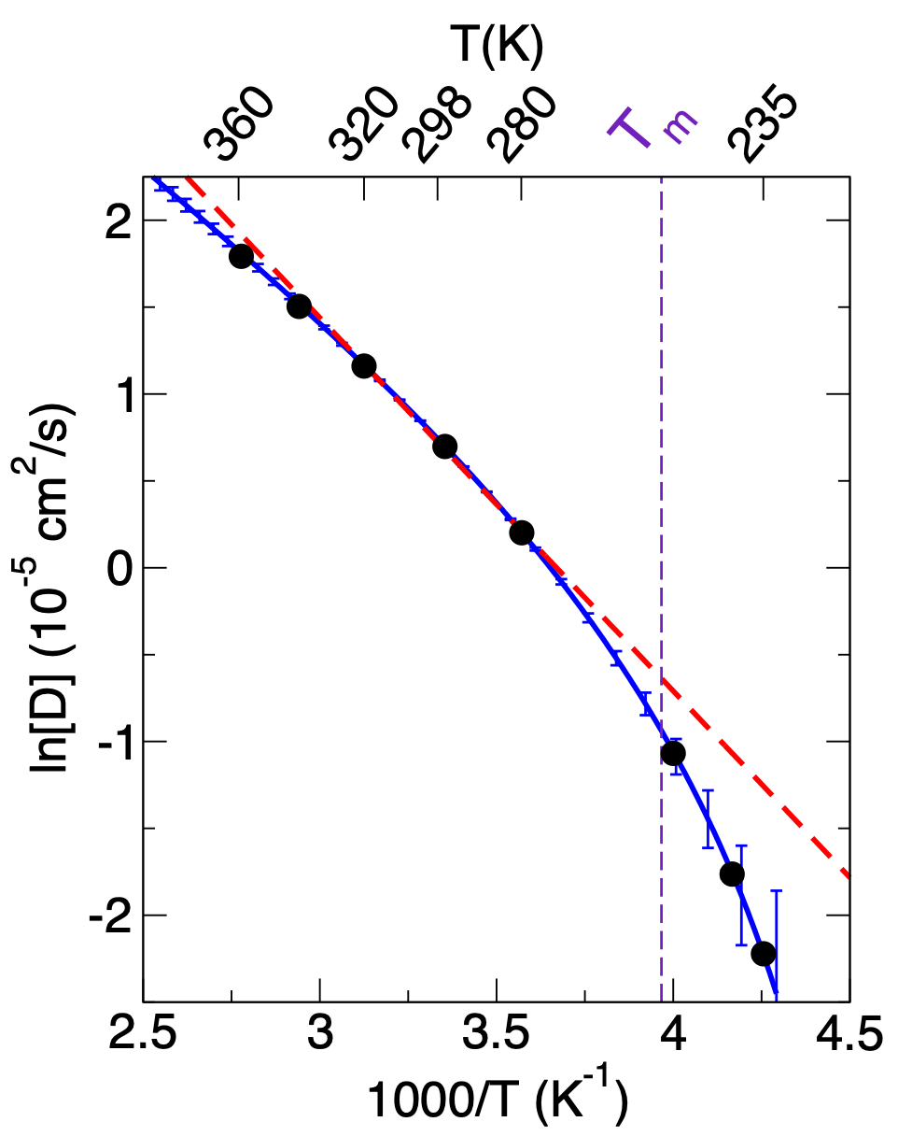


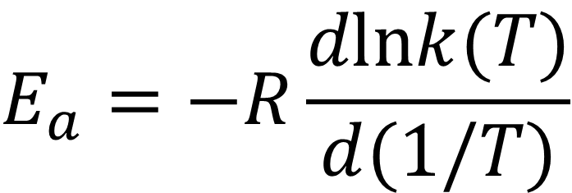





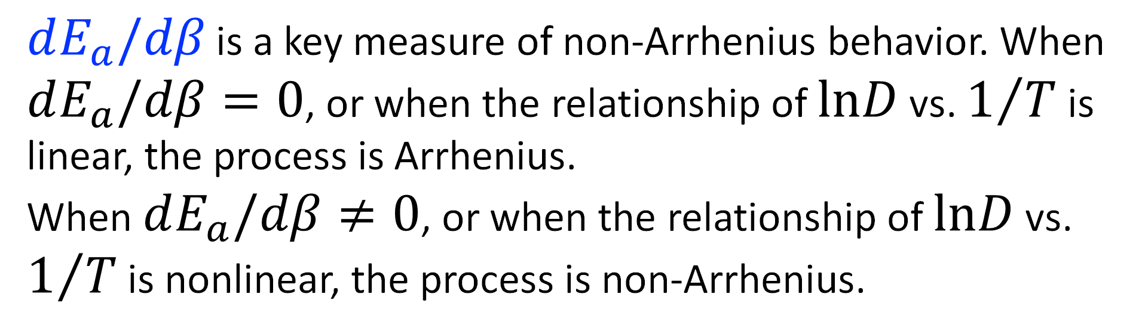
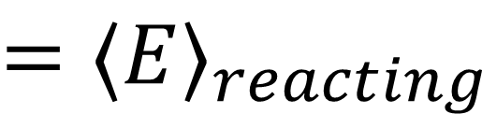



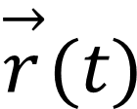
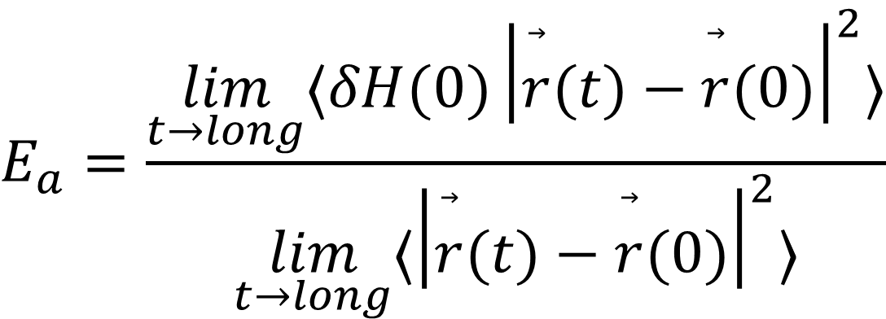
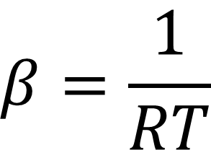

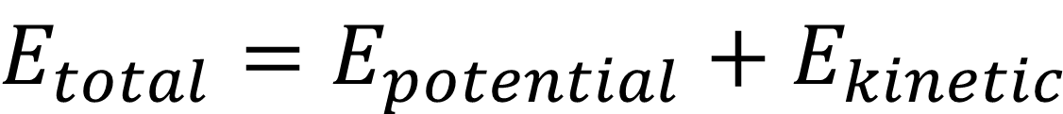
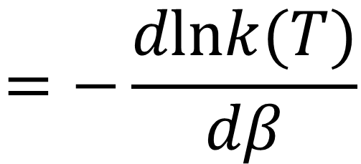
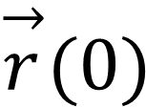
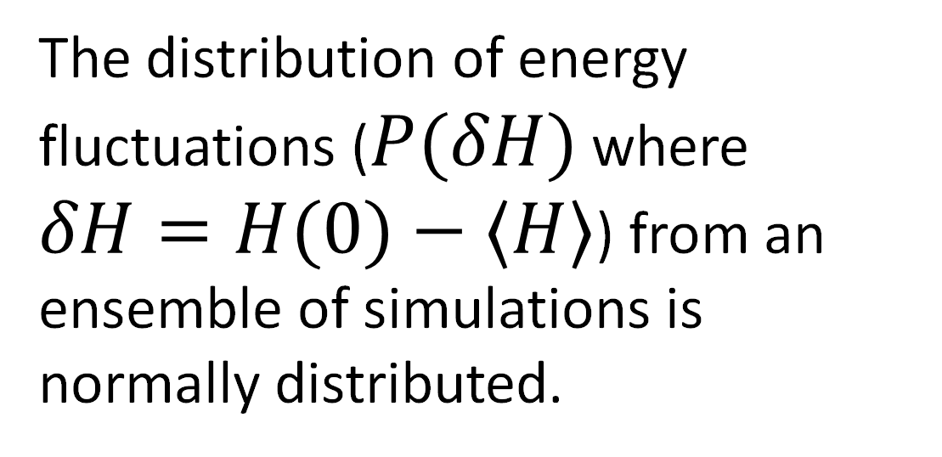
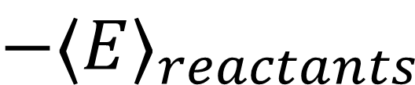
A New Look at Activation Energies
Elizabeth R. Bartlett, Ward H. Thompson
Department of Chemistry, University of Kansas, Lawrence, Kansas USA
´´
What is an activation energy?
The traditional (Arrhenius) approach poses limitations
Activation energies from single temperature simulations:
Fluctuation Theory for Dynamics
‡
The Arrhenius Equation
$$\text{slope}=−\frac{E_{a}}{R}$$
$$E_{a}$$
$$=⟨E⟩_{reacting}$$
$$−⟨E⟩_{reactants}$$
$$k=Ae^{−E_{a}/RT}$$
To address the limitations of the Arrhenius approach, our group developed a method to compute activation energies from simulations at a single temperature by evaluating the analytical derivative of the rate or timescale of interest that the Arrhenius analysis estimates numerically.
The activation energy can be found as the slope of ln(k) vs. 1/T
ln(k)
reactants
$$E_{a}=−R\frac{dlnk(T)}{d(1/T)}$$
products
$$=−\frac{dlnk(T)}{dβ}$$
where
$$β=\frac{1}{RT}$$
The activation energy ($E_{a}$) is the energy the system
must have to overcome the barrier to react
1/T
Processes to consider:
But it can be challenging to study processes across temperature ranges:
J. Chem. Phys. 147, 134103 (2017)
Nature Physics 6, 685–689 (2010)
J. Phys. Chem. B 128, 4783 (2024)
The distribution of energy fluctuations ($P(δH)$ where $δH=H(0)−⟨H⟩$) from an ensemble of simulations is normally distributed.
The mean-squared displacement is a time correlation function related to diffusion:
$$MSD(t)=⟨|\overset{→}{r}(t)−\overset{→}{r}(0)|^{2}⟩$$
Getting out of bed in the morning: Consider the difference in the energy the system (you) must have on a cold, snowy day compared to a warm, sunny day!
Near a phase transition, it can be challenging to measure the property of interest as a system’s phase changes.
In gas-expanded liquids and electrolytes, temperature changes can alter the system’s composition through changes in gas solubility. This complicates the measurement and interpretation of activation energies.
A
B
+
C
D
$$⇆$$
A
C
+
B
D
$$E_{a}=\frac{\lim_{t→long}⟨δH(0){\left|\overset{⃗}{r}(t)−\overset{⃗}{r}(0)\right|}^{2}⟩}{\lim_{t→long}⟨{\left|\overset{⃗}{r}(t)−\overset{⃗}{r}(0)\right|}^{2}⟩}$$
Chemical reactions: This can depend on the relative strengths of the reactant and product bond(s), as well as solvent interactions.
And not all processes are Arrhenius:
Supercooled water diffusion exhibits non-Arrhenius behavior at cooler temperatures. In this case, the activation energy is not sufficient to describe the change in dynamics with temperature. The activation energy itself is temperature dependent.
Effectively, from an ensemble of simulations, we compute the activation energy as the correlation between the system’s energetics and the dynamics of interest. For water diffusion, simulations with faster dynamics tend to have higher energies, while slower dynamics correspond to lower energies. As a key advantage, this method can be extended to compute non-Arrhenius effects through the calculation of $δE_{a}/δβ$.
$$\overset{→}{r}(0)$$
$$\overset{→}{r}(t)$$
Arrhenius
Simulation
$$dE_{a}/dβ=0$$
see, e.g., Xu et al.. Proc. Natl. Acad. Sci. 113, 14921–14925 (2016).
$dE_{a}/dβ$ is a key measure of non-Arrhenius behavior. When $dE_{a}/dβ=0$, or when the relationship of $lnD$ vs. $1/T$ is linear, the process is Arrhenius.
When $dE_{a}/dβ≠0$, or when the relationship of $lnD$ vs. $1/T$ is nonlinear, the process is non-Arrhenius.
Molecular diffusion: By considering diffusion an activated process, we can understand the energetic driving forces behind molecular dynamics.
Experiment
$$dE_{a}/dβ≠0$$
Mechanistic insight:
From molecular dynamics simulations, we can decompose the total system energy into contributions from different interactions and motions in the system.
For example,
Acknowledgments
$$E_{total}=E_{potential}+E_{kinetic}$$
NSF Grant No. CHE-2419107
NSF Grant No. MRI-2117449
Madison and Lila Self Graduate Fellowship
We can similarly correlate the dynamics of interest with each energetic contribution, providing us insight into the driving forces of the dynamics. This mechanistic insight is not available through any other method!
Reorientational dynamics: For water, as an example, we can calculate activation energies of reorientation, which provide insight into the role of hydrogen bonding.

